Slide 1
REMOTE WORK HEALTH IMPACT SURVEY 2025
Submitted by,
ANN MARIYA JOSE

Slide 2

INTRODUCTION
Remote work is now a key feature of the modern workforce
Post-pandemic remote and hybrid work have changed how organizations and employees function
These changes impact employee well-being, productivity, and work–life balance
The dataset includes variables such as mental health, burnout, physical health, work hours, and social isolation
It allows analysis of relationships between remote work intensity and burnout
It also helps examine mental and physical health trends across industries

Slide 3
OBJECTIVES
To examine the overall impact of different work arrangements on employee health outcomes.
To assess the relationship between remote work intensity (hours per week) and burnout level
To analyze whether mental health conditions are more prevalent in specific work arrangements.
To explore how social isolation scores vary among employees in work arrangements.
To identify work-life balance and social-isolation score by salary-range.

Slide 4
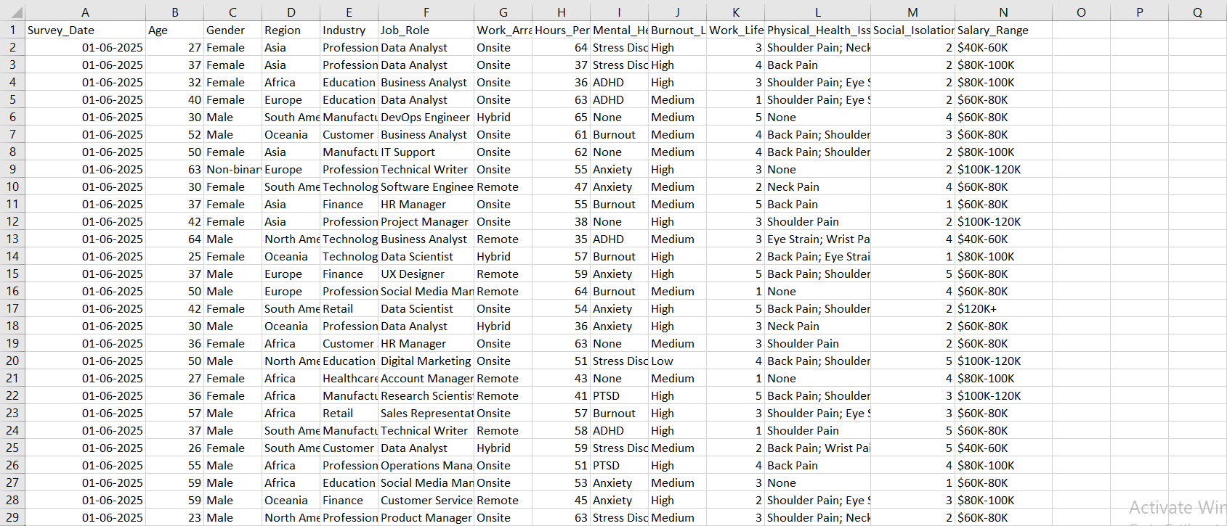
DATASET

Slide 5
DATASET STRUCTURE
Rows – 3K+
Columns – 14
Survey date – Date when the survey response was submitted (YYYY-MM-DD)
Age – Age of the respondent (in years)
Gender – Gender identity of the respondent
Region – Geographical region of employment
Industry - Industry sector of the respondent
Job role – Specific job title
Work arrangements – Primary work mode
Hours per week – Average number of hours worked per week

Slide 6
Mental Health status - Primary self-reported mental health condition
Burnout level – Self-assessed burnout (categorical: Low, Medium, High)
Work life balance score – Self-rated work-life balance on a scale of 1 (poor) to 5 (excellent)
Physical health issues – Self-reported physical health complaints
Social isolation score – Self-rated social isolation on a scale of 1 (none) to 5 (severe)
Salary range - Annual salary range in USD

Slide 7
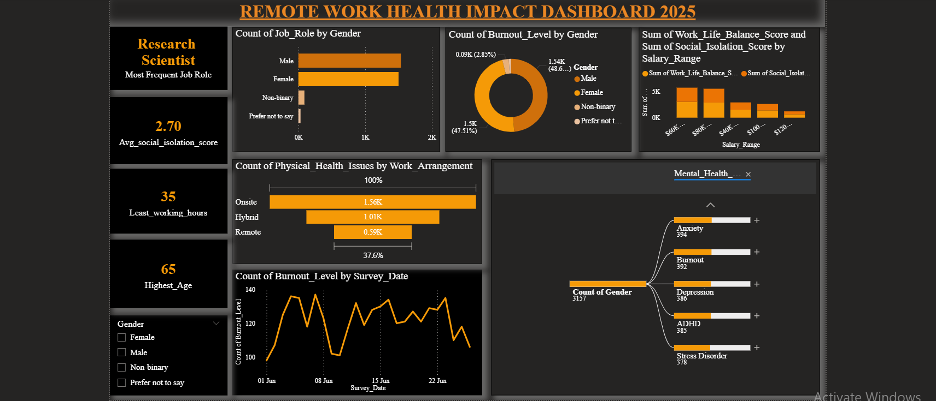
DASHBOARD

Slide 8
CRITERIAS USED
Count of job role based on gender – Clustered bar chart
Physical health condition over work arrangement – Funnel chart
Burnout level by survey date – Line chart
Gender-wise burnout level – Donut chart
Work-life balance and social-isolation score by salary range – Stacked column chart
Mental-health status and Industry by gender – Decomposition tree
Gender –slicer

Slide 9
CRITERIAS USED
Age Category = SWITCH ( TRUE(),
[Age] >= 22 && [Age] <= 35, "22-35", [Age] > 35 && [Age] <= 50, "36-50",
[Age] > 50 && [Age] <= 65, "51-65",
BLANK())
Maximum age=
MAX(post_pandemic_remote_work_health_impact_2025[Age])
Minimum age= MIN(post_pandemic_remote_work_health_impact_2025[Age])
Average Social Isolation = ScoreAVERAGE(post_pandemic_remote_work_health_impact_2025[Social_Isolation_Score])

Slide 10
CONCLUSION
The 2025 post-pandemic dataset shows a complex link between work arrangements, well-being, and job demands
Remote and hybrid work did not fully reduce stress or improve work–life balance as expected
Health challenges exist across all work types: onsite, hybrid, and remote
Work–life balance scores remain low to moderate
Flexibility alone does not ensure better personal time or reduced stress

Slide 11
SUGGESTIONS
Implement structured mental health support across all work arrangements
Promote clear work–life boundaries to prevent burnout
Monitor employee well-being regularly using surveys and check-ins
Tailor wellness programs by industry and gender-specific needs
Encourage manageable workloads, not just flexible schedules
Foster social connection to reduce isolation in remote and hybrid team

Slide 12
REFERENCES
https://www.kaggle.com/datasets/pratyushpuri/remote-work-health-impact-survey-2025

